Slide 1
Care of patients with special problems

Slide 2
Care of patients with special problems
Goal
After completion of this lesson the student will be able to make the necessary modifications in his work when dealing with patient who is :
very ill,
severely injured,
very young or very old,
confused, or combative.

Slide 3
Behavioral Objectives
After studying this lesson The student will be able to:
1. list the special care considerations necessary in diagnostic imaging/radio therapy when the patient is infant or child.
2. demonstrate the safe methods of restraining a pediatric patient.
3. list the special problems of the geriatric patient in diagnostic imaging and the special care required for them.
4. list the precautions to be taken if the patient has a head injury.
5. list the precautions to be taken if the patient has facial injury.
6. list the precautions to be taken if the patient has a possible spinal cord injury.
7. list the precautions to be taken if the patient has a fracture or possible fracture.
8. list the precautions to be taken if the patient is confused, agitated , or assaultive

Slide 4
Introduction
Pediatric patients range in age from infancy to 14 years of age.
They require special care, depending on their age and their ability to understand.
The RT must first determine the age of the child and then decide how he will communicate most successfully with the child.

Slide 5
…Introduction
The infant will be accompanied by worried parents.
They will be the persons to whom the examination or procedure should be explained.
Older children, however, will need a personal explanation.
In all cases, care of the paediatric patient requires that the RT be honest and gentle, but firm.

Slide 6
…..Introduction
The elderly patient also has special needs.
As a person ages, there is a gradual decline of all bodily functions.
This decline varies with each patient.
So the RT must assess the aged patient’s abilities in order to determine what adaptations he will want to make to keep the patient safe and comfortable during the diagnostic procedure or treatment.

Slide 7
…..Introduction
A patient who is:
confused,
agitated, or
combative
will require special consideration in order to protect both patient and RT from injury.

Slide 8
….Introduction
The patient may have a fracture, a spinal cord injury, facial injuries, or acute abdominal pain.
They are usually first admitted to the emergency ward and then are send to for diagnostic procedures.
In such cases some patients may not be able to be transferred, and the radiographs may have be taken on the bed/ trolley itself.
Producing high quality radiographs may not be possible. But must settle for best exposures that that the situation allows without extending the injury or causing the patient extreme pain and discomfort.
The RT must exercise great care and understanding when dealing with patients suffering from traumatic injuries and with the critically ill.

Slide 9
1. The paediatric patient
Children of all ages respond in a positive manner to honesty and friendliness.
A small child may be very frightened when he enters the x-ray department with darkened rooms and massive equipment
If the RT can spend a few moments establishing rapport with the child and acquainting him with the new environment, he can save a great deal of time later.
The work will proceed more smoothly, and the RT will have a more secure and content patient.

Slide 10
….paediatric patient
Children are resistant to immediate close contact with strangers.
Therefore, it is best to talk at a comfortable distance and allow the child to become accustomed to your presence before you approach him.
The RT must explain just what is going to occur during the procedure to the child who is old enough to understand.
He should also tell how long the procedure will last and what will be expected of the patient.
The child should be prepared for any discomfort that he may feel.

Slide 11
….paediatric patient
If the child is to receive medication, the method of administration should be explained.
Explanation to the child are more effective if they are brief and to the point.
Do not give the child choices when this is not appropriate because this may be confusing to him.
Parents who accompany their child will feel less anxious if they too are given an explanation of the treatment or procedure.
The small child is more responsive to a parent’s request and will allow the parent to dress or hold him without feeling the anxiety that might be present if a stranger were to do so.

Slide 12
Restraining the anxious child
Occasionally the very anxious child will not be able to stay quietly long enough for a successful diagnostic procedure, and he will have to be restrained.
In other situations, a child may not be able to be safely held in position for an examination and restraints will be necessary.
Restraints should be used only when no other means are safe or logical and should be of a quality that will not cause injury to the patient.
The child must be made to understand before the restraint is applied that this is not a method of punishment.

Slide 13
Methods of Restraining a child
There are several methods of restraining children.
using a folded sheet.
using commercial restraints
holding by assistants
………………………….?

Slide 14
Precautions - Restraining a child
If a child is to be physically restrained by an assistant, the RT must instruct him not to be too forceful in his hold. Care should be taken not to pinch or bruise the skin or to interfere with circulation.
It is better to use a sheet or mechanical restrain than to have the assistant use force, because the former is less frightening to a child.
In order to prevent a child rolling his from side to side, the person holding the child should stand at the end of the table and support the child’s head between his hands, making sure that there is no pressure on the ears or on the fontanels.
Any person who holds a child during x-ray procedures must wear a protective lead apron.

Slide 15
Sheet restraints
Sheet restraints are effective and can be formed into any size or fashion desired.
Take a large sheet and fold it lengthwise. Place the top of the sheet at the child’s shoulders and bottom at the feet. Leave a greater portion of the sheet at one side of the child. Bring the longer side back over the arm and under the body and other arm. Next, bring the sheet back over the exposed arm and under the body again. This type of restraint keeps the two arms safely and completely restrained and leaves the abdomen exposed.

Slide 16
Sheet restraint

Slide 17
Mummy-style sheet restraints
It is made by folding a sheet or a blanket into a triangle and placing it on the radiographic table. The distance from the fold to the lower corner of the sheet should be twice the length of the child.
Place the child onto the sheet with the fold slightly above the shoulders.
Bring one corner of the sheet over one arm and under the body.
If both arms are to be restrained, do the same with the other side of the sheet.
If the legs are to be restrained, turn the sheet and repeat the procedure for the legs.
This restraint can be used to restrain one extremity or all extremities.

Slide 18
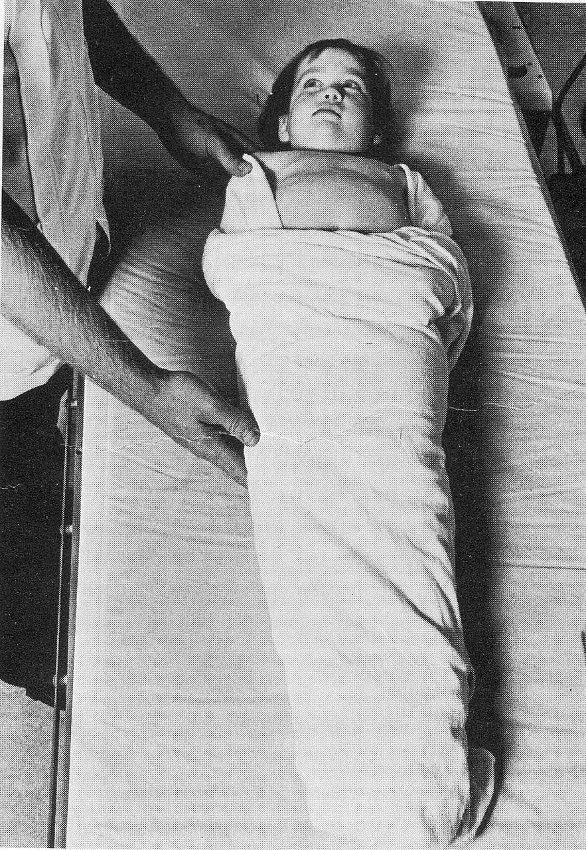
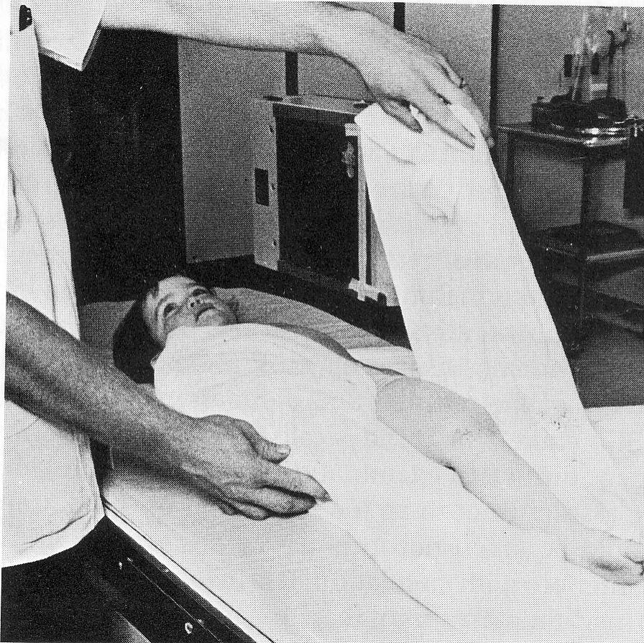
Mummy style sheet restraint

Slide 19
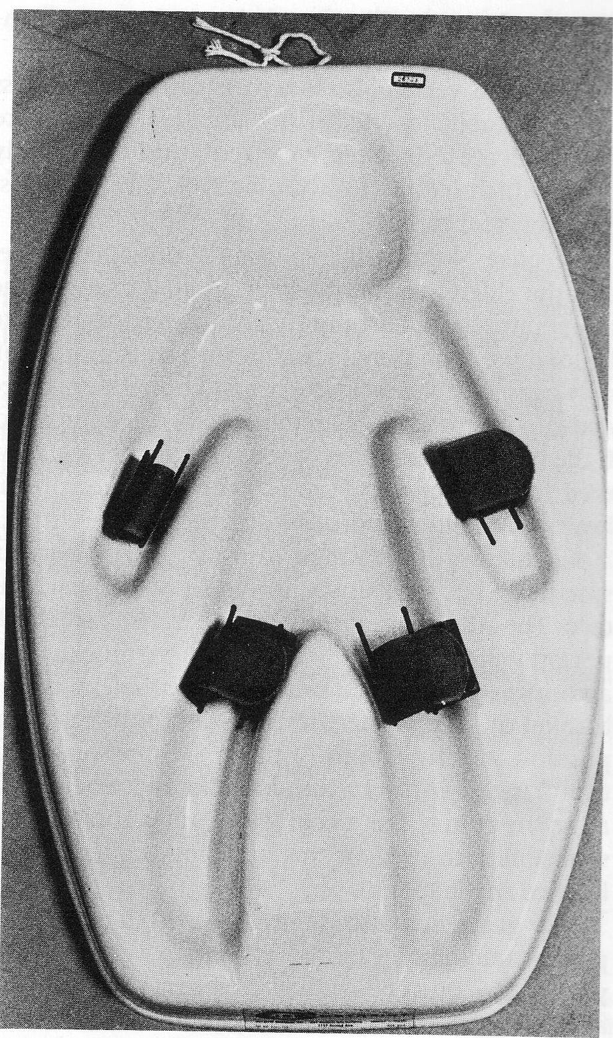
Commercial restraints

Slide 20
2. The geriatric patient
Throughout the life cycle, the body undergoes normal physiologic and anatomic changes.
These changes occur at different times from person to person.
Lifestyle as well as hereditary factors contributes greatly to the aging process.
As the body ages, the bones become less dense, and fractures occur more easily.
This is specially true of the vertebral bodies and the femur.
The RT must keep this in mind when moving the elderly patient or directing him to move, because even a slight deviation in he usual pattern of movement may cause a fracture.

Slide 21
….Geriatric patient
As the aging process continues, body tissues lose elasticity.
Both the speed and the strength of muscle response diminish.
This decrease in tissue elasticity effects the lungs particularly which do not expand and contract as effectively as they did earlier.
This in turn increases the likelyhood that pulmonary congestion and pneumonia may develop.
The blood vessels also loose their elasticity.
This loss may eventually lead to an increase in blood pressure and a decrease in effective circulation to all body parts, which could affect the body’s ability to resist infection and to heal

Slide 22
….Geriatric patient
Because of these factors the elderly person tolerates position changes and temperature changes poorly.
He/she may not be able to remain in one position longer.
Head low or feet low position may produce poor circulation to the parts at higher level.
At low temperature they become chilled easily. Offering a blanket or a flannel sheet will reduce this problem.
Skin damage can occur easily when moving, so special care must be taken.
The swallowing may be slowed and may choke easily. So care must be taken when giving oral contrast agents.

Slide 23
…Geriatric patient
Slight change in normal routine may disturb physiologic homeostasis in the elderly patient.
So, if the elderly patient is required to fast prior to a diagnostic procedure, the examination should be scheduled for an early morning hour so that the patient can have his breakfast close to the usual time.
The mental processes may diminish and a person who stays long hours may be confused.
The RT must be prepared to assist the patient back to the dressing room, toilet and back to ward etc.
He should assess the patient’s ability to hear and see.

Slide 24
…geriatric patient
Increased anxiety may affect the elderly patient’s ability to interpret directions.
You should give directions in a quiet area and restate the message as often as necessary.
Never give an elderly patient a list of directions to read or a list of verbal instructions and expect that they will be able to understand and follow them.
Go over the list with them and have them repeat what the directions state until you are certain that they understand the message.

Slide 25
3. The Patient with a Head Injury
The term head injury may refer to any injury of the skull, the brain, or both, which requires medical attention.
These injuries are all potentially serious because they may involve the brain, which is the seat of consciousness and controls every human action.

Slide 26
…Head injury
There are two basic types of head injury, open and closed.
With an open injury to the skull or meninges, the brain is vulnerable to damage and infection because its protective casing has been broken.
If the injury is closed (blunt injury), the brain tissue may swell; the swelling is limited by the confines of the skull, and the resulting pressure may cause extensive brain damage.
The brain has little healing power, so any injury to it must be considered potentially permanent and serious

Slide 27
…Head injury
Fractures at the base of the skull often have accompanying fractures of the facial bones.
This type of injury may result in a tear in the dura, the outer membrane surrounding the brain and spinal cord, and a leakage of cerebral spinal fluid may result.
The RT must consider all patients with head injuries to have accompanying cervical spinal injuries until it is medially disproven.
Precautions to alleviate potential extension of these injuries must be taken as a matter of routine.

Slide 28
Signs and symptoms of Closed head injury
Varying degree of consciousness ranging from drowsiness, confusion, irritability, and stupor to coma.
Lucid periods followed by periods of unconsciousness possible.
Loss of reflexes
Changes in vital signs
Headache, visual disturbances, dizziness, and giddiness
Gait abnormalities
Unequal pupil dilatation
Seizures, vomiting, and hemiparesis

Slide 29
Signs & symptoms of open head injury
Abrasions, contusions, or lacerations apparent on the skull
A break or penetration in the skull or meninges apparent by inspection or on radiographs
Basal fractures may result in leakage of cerebrospinal fluid demonstrated by leakage of blood on the sheet or dressing surrounded by a yellowish stain (halo sign)
Varying level of consciousness
Subconjunctival hemorrhage
Hearing loss
Periorbital ecchymosis (raccoon’s eye)
Facial nerve palsy

Slide 30
RT Action
Keep the head and neck immobilized until injury to the cervical spine is ruled out.
Do not remove the sandbags, collars, or dressings; make all radiographs with these in place.
Wear sterile gloves if in contact with open wounds to prevent infection.
Check vital sings
Observe for signs and symptoms of hypoxia, respiratory arrest, changes of level of consciousness.
Notify the physician or the nurse.

Slide 31
4. The patient with a facial injury
Injuries to the facial bones are usually associated with injury to soft tissues of the face.
Often these injuries do not seem serious, but they are all potentially disfiguring.
The RT must treat all patients who have serious facial injuries as if they also have basal skull fractures and injuries of the cervical spine until such injuries are ruled out.

Slide 32
Signs & symptoms of facial injury
Misalignment of the face or teeth
Pain at site of injury
Eccymosis of the floor of mouth and buccal mucosa
Distortion of facial symmetry
Inability to close the jaw
Edema
Abnormal movement of the face or jaw
Flatness of the cheek
Loss of sensation on side of injury
Diplopia
Blindness caused by detached retina
Nosebleed
Conjunctival hemorrhage
Paresthesia
Halo sign (indicates basal skull fracture with leaking cerebrospinal fluid)
Changes in level of consciousness

Slide 33
RT action
Observe for airway obstruction. Watch for noisy, labored respiration.
Do not remove sandbags, collars, or other supportive devices or move a patient unless supervised by a doctor
Apply a sterile pressure dressing if bleeding is profuse and call for assistance.
(Patient must not be suctioned through nasal passages).
Wear sterile gloves if in contact with open wounds.
If you find teeth that have fallen out, place them in a container moistened with gauze soaked in sterile water.
Be prepared to assist with oxygen and other emergency treatment if necessary.
Observe for symptoms of shock; notify the physician

Slide 34
5. The patient with a spinal cord injury
The spinal cord carries messages from the brain to the peripheral nervous system.
It is housed in the vertebral canal, which extends down the length of the vertebral column.
The spinal cord is protected by the fluid in the canal and by the vertebrae.
Motor function depends on the transmission of messages from the brain to the spinal nerves on either side of the spinal cord.
Injury to or severing of the spinal cord causes message transmission to cease.
The result is a cessation of motor function and partial or complete cessation of physical function from the level of damage to the cord to all parts below that level

Slide 35
….spinal injury
Most spinal cord injuries occur in the cervical or lumbar areas because these are the most mobile parts of the spinal column.
The spinal cord loses its protection when there is injury to the protective vertebrae, and such an injury may result in compression or complete severing of the cord.
Cord tissue, like brain tissue, has little healing power; injuries to it usually cause permanent damage

Slide 36
Signs & symptoms of Complete transaction of spinal cord
Flaccid paralysis of the skeletal muscles below the level of the injury
Loss of all sensation (touch, pain, temperature, or pressure) below the level of injury; pain at site of injury possible
Absence of somatic and visceral sensations below the site of injury
Unstable, lowered blood pressure
Loss of ability to perspire below level of injury
Bowel and bladder incontinence

Slide 37
Signs & symptoms of partial transaction of spinal cord
Asymmetrical, flaccid paralysis below level of injury
Asymmetrical loss of reflexes
Some sensory retention: feeling of pain, temperature, pressure, and touch
Some somatic and visceral sensation
More stable blood pressure
Ability to perspire intact unilaterally

Slide 38
RT action
Monitor vital signs with special attention to respiration.
Maintain an open airway; call for assistance if respirations become noisy or labored.
Do not move the patient for radiographs until diagnosis is confirmed and physician instructs.
Do not move head or neck even if it is in an awkward position
Do not remove sand bags, collars, antishock garments, or other supports until diagnosis is confirmed and physician advices
Observe for signs and symptoms of shock
If patient is to be moved, do so with at least four persons assisting and under medical supervision.

Slide 39
6. The patient with a fractured extremity
A fracture may be defined as a disturbance in the continuity of a bone. Fractures can be classified simply as open or closed.
The term ‘open fracture’ indicates a visible wound that extends between the fracture and the skin surface. The broken bone itself often breaks through the soft tissue, making the fracture clearly visible.
A ‘closed fracture’ may not be obvious to the untrained eye. Often there is swelling around the injured area, pain, and a deformity of the limb. All or some of these symptoms may be absent and a closed fracture still be present.

Slide 40
…..fracture
Internal injuries caused by fractures of the pelvic bones are a leading cause of death following automobile accidents.
Therefore when caring for patients with traumatic injuries a possibility of a pelvic fracture should always be considered.
Extreme care must be used when making diagnostic radiographs because the slightest movement may initiate hemorrhage or irreparable damage to a vital organ.
Hip fractures are common accidents in elderly patients as a result of bony changes related to age and disease.
This is a common home accident for elderly patients. They too must be treated with the utmost care in diagnostic imaging to prevent any extension of injuries.

Slide 41
Signs & symptoms of fracture
Pain and swelling
Functional loss
Deformity of the limb
Grating sound or feel of grating (crepitus) if moved
Discoloration of surrounding tissue caused by hemorrhage within tissue (in closed fracture)
Overt (obvious) bleeding (open fracture)
Possible signs and symptoms of shock

Slide 42
RT action
Do not move affected limb or body part
Patient move must be done under direction of the physician
Do not remove splints or any type of supports
If moving a splinted limb, support the joint above and below the fracture, and at the joints
Wear sterile gloves when dealing (in contact) with open fractures
Observe the patient for signs and symptoms of shock.

Slide 43
7. The patient with acute abdominal distress
There are many reasons for acute abdominal pain.
Among them are;
internal injuries that cause hemorrhage
appendicitis
bleeding ulcers
ectopic pregnancy
cholecystitis
pancreatitis
bowel obstruction

Slide 44
…Acute abdominal distress
Whatever the cause of the distress, the symptoms are somewhat similar.
It will be the RT’s responsibility to make the diagnostic radiographs as quickly as possible and with least possible discomfort to the patient.
Patients with acute abdominal distress are frequently sent to the operating room for a surgical procedure following diagnosis.

Slide 45
Signs & symptoms of acute abdomen
Severe abdominal pain.
A rigid abdomen.
Nausea and vomiting.
Extreme thirst.
Possible symptoms of hypovolamic shock.

Slide 46
RT action
Call for assistance if the patient is too ill to help move himself
If the patient is unable to stand for upright exposures, use other means of obtaining necessary diagnostic information
Transport the patient by gurney
Have an emesis basin and tissues nearby in case vomiting occurs.
Do not give the patient anything to eat or drink.
Observe for signs and symptoms of shock, and prepare for emergency treatment.

Slide 47
8. The agitated or confused patient
Some patients from mental health units and patients with emotional problems fall into this category.
They are frequently agitated or confused and may become combative.
This behaviour may be caused by chemical abuse or psychosis of varying etiologies.
At times, the confused elderly patient forgets that he is not at home and mistakes the RT for an intruder from whom he must protect himself by attack.
Whatever the cause, the RT must take precautions to protect himself and the patient when this type of behaviour is threatened.

Slide 48
….agitated……
Patients whom the RT can predict will demonstrate combative behaviour are those who have a history of growing confusion and disorientation.
Other warning signals are:
increasing agitation demonstrated by rapid pacing back and forth across the room;
a patient in animated and increasingly noisy conversation with a person who is not present;
a demonstration of illogical thought process;
refusal to cooperate; distrust of the RT and his explanation of a procedure;
examination of the diagnostic room or equipment unnecessarily.

Slide 49
…..combative patient
Patients who are combative may occasionally display no emotion at all, or, display irrational fear of a procedure.
Patients who react in a combative or aggressive manner usually do so because they feel that they have no control of what is happening to them.
They resort to violent behaviour as a means of self-protection.

Slide 50
Approaching a combative patient
Before approaching a patient who is not reacting in a rational manner, the RT should discuss the case with the nursing personnel or with the physician.
If the patient is behaving in a combative manner or has a history of combativeness, the RT should request assistance with the examination.
Trust your instincts about a patient’s behaviour.
Do not isolate yourself with a potentially assaultive patient.
Always have a door open, and position yourself so that you are able to leave the room if necessary.
If you feel that the patient is apt to become violent, do not begin the procedure without assistance from a person who can protect you and the patient if necessary. (usually a security officer).

Slide 51
…Approaching a combative patient
At times, patients who are agitated or confused react more favourably to persons of one sex or another. If this seems to be the case, have an RT of the preferred sex conduct the procedure.
When approaching a patient who is agitated, do so from the side, not face to face.
Never touch a confused or agitated patient without first asking his permission and explaining.
Use simple, concise statements to explain your purpose.
If the patient is speaking in a delusional or irrational manner, do not become involved in his conversation.
If the patient refuses to be radiographed, simply stop and return him to the ward.

Slide 52
If the radiograph is essential to the patient’s treatment, he will have to be restrained and supervised by the appropriate persons.
If the situation escalates beyond control and the patient is actually prepared to strike you, put as much distance as possible between yourself and him.
Let him know that you are uneasy and ask what can be done to appease him.
Ally yourself with the patient by statements such as, “You must be really angry at the people here for putting you through all of these tests.”
If this does not work, get out of the area and summon help.
Do not approach the patient or make any effort to take anything out of his hands.

Slide 53
Summary
1. list the special care considerations necessary in diagnostic imaging/radio therapy when the patient is infant or child.
2. demonstrate the safe methods of restraining a pediatric patient.
3. list the special problems of the geriatric patient in diagnostic imaging and the special care required for them.
4. list the precautions to be taken if the patient has a head injury.
5. list the precautions to be taken if the patient has facial injury.
6. list the precautions to be taken if the patient has a possible spinal cord injury.
7. list the precautions to be taken if the patient has a fracture or possible fracture.
8. list the precautions to be taken if the patient is confused, agitated , or assaultive

