Slide 1
Infection Control
Goal
To learn techniques for controlling infection during patient care and accept responsibility for infection control during radiography.

Slide 2
Objectives
After completing this chapter you will be able to:
Define the relevant terminology
List and describe four types of microorganisms
List and define three elements needed to produce an infection
List and explain four means of transmitting microorganisms
Describe 12 methods that can be used routinely to control infection in practice of Radiography
Demonstrate the correct method of hand-washing for medical asepsis
Define the seven category-specific methods of isolation
Demonstrate the correct method of entering and leaving an isolation room by means of strict isolation technique.

Slide 3
Introduction
Infection control in health care institutions is essential to the safety of
Patients
Their families, and
Healthcare workers.
All health workers are taught the concepts and procedures of infection control
Patients are also responsible for complying with infection control measures while in the hospital.
Their visitors must also comply.

Slide 4
Introduction continued
People come to the radiology department from many different environments they will bring disease with them.
Though some patients arrive in apparent good health, all must be regarded as potential carriers of disease.
Every piece of equipment must be thoroughly cleaned after each use
RT must use every means available to protect his patient, his coworkers and himself from infection.

Slide 5
NOSOCOMIAL INFECTIONS
The infections acquired by patient while in hospital
The frequent types of nosocomial infections are,
Urinary tract infections associated with the use of indwelling catheters.
Wound infections following surgical procedures
Respiratory tract infections
Strict precautions should be taken to prevent this type of infections
Notes:
In spite of increasing use of infection control measures, the incidence of this type of infections are on the rise. This may be attributed to the following facts;
The rise in severity of illness an injuries for which the people are hospitalized
The increased number of elderly persons who make up the hospital population
The increase use of potent immunosuppressive and cytotoxic drugs
Radiation.
Another contributing factor is that the antimicrobial drugs used to treat the infections change the normal bacterial flora of the body. This encourages the growth of hospital bacteria that have learned to resist antimicrobial rugs.
The use of intravenous catheters, respiratory therapy equipment, and transducers requires meticulous infection control technique because they are frequently implicated as the cause of nosocomial infections.

Slide 6
MICROORGAMISMS
Four major groups of microorganisms
Bacteria
Fungi
Viruses
Protozoas
Within these four groups there are many species
i. Some of them may produce infections in man
ii. Some are useful and/or not harmful.

Slide 7
Some microorganisms that are natural flora in one area of the body produce infection are in an other area.
E.g., Escherichia coli, normally inhabits the human intestinal tract,
can cause urinary tract infection if it enters to the urinary bladder.
Unharmful Microorganisms are,
used in food and drug processing
destroy waste

Slide 8
Bacteria
Minute, one-celled organisms without a typical nucleus.
Contain both DNA (deoxyribonucleic acid) and RNA (ribonucleic acid).
DNA carries the inherited characteristics of a cell.
RNA constructs cell protein in response to the direction of DNA
Bacteria are classified according to their shape.
Cocci – (spherical)
Bacilli – (oblong)
Spirilla – (spiral)
They may be classified according to their divisional grouping.
Diplococci – (groups of two)
Streptococci – ( chains)
Staphylococci – (grapelike bunches)
They may also be classified by their reaction to various staining processes in laboratory.
Gram-positive – (bacteria take the stain)
Gram-negative – (bacteria do not take the stain)
Acid-fast - ( bacteria are resistant to decolorization by alcohol).

Slide 9
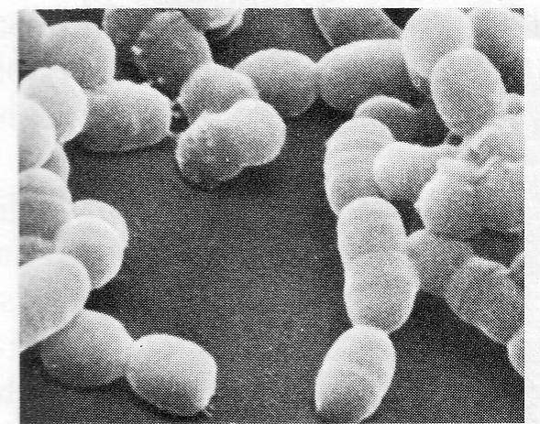
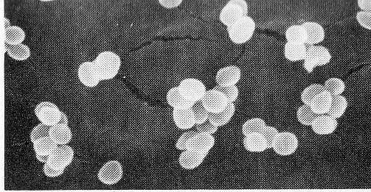
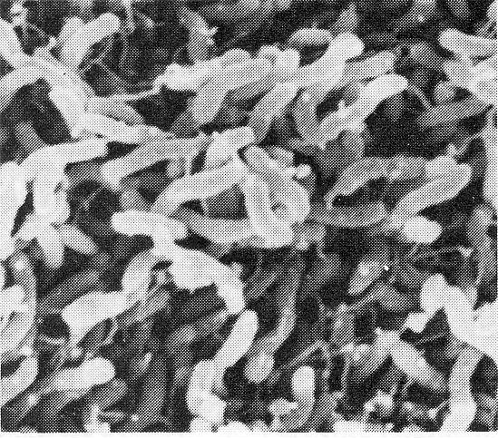
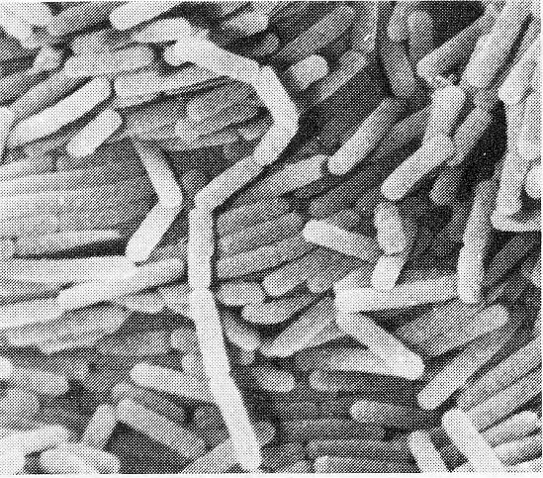
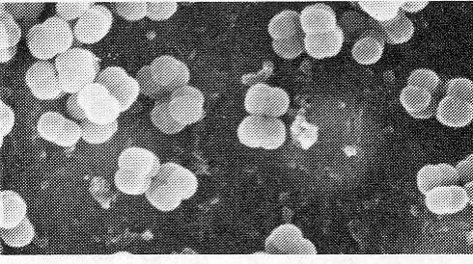
Forms of Bacteria – Cocci & Bacilli
Staphylococcus epidermidis
STEPTOCOCCUS MUTANTS
Micrococcus lutes
Bacillus cereus
Flagellated bacilli

Slide 10
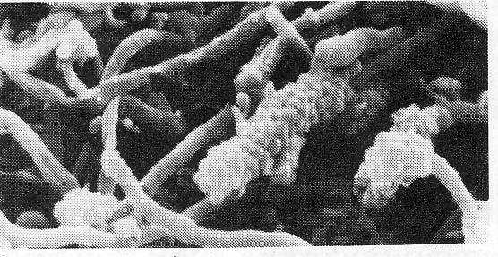
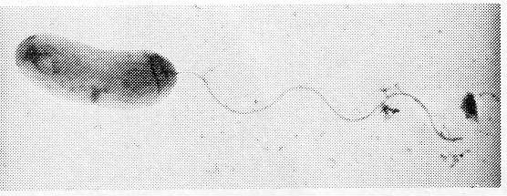
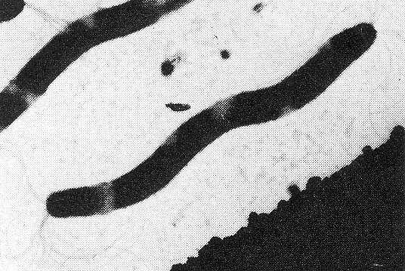
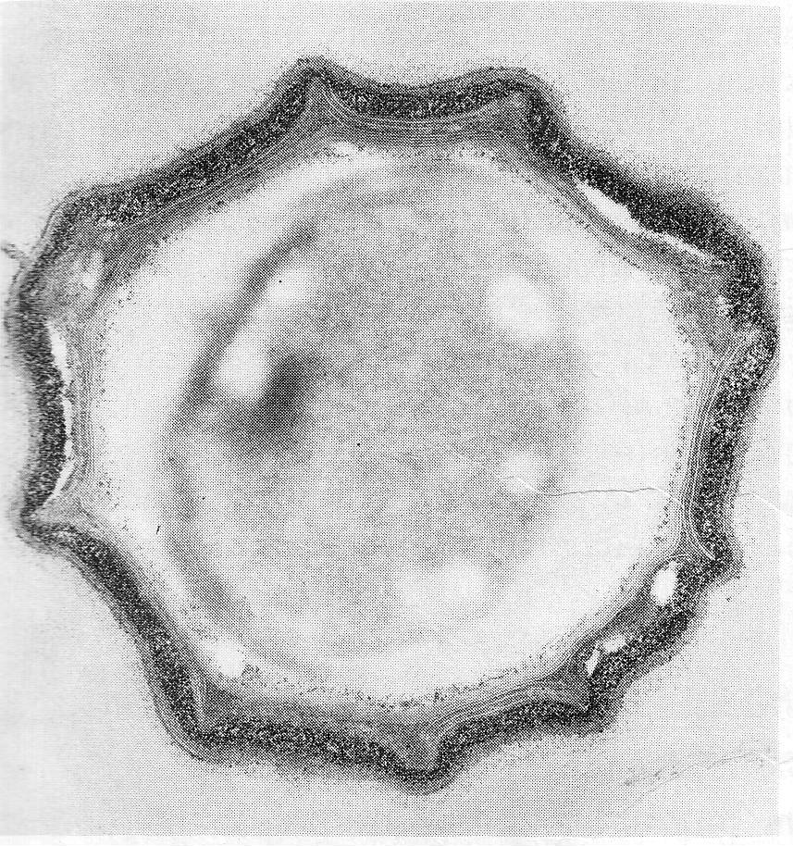
Forms of Bacteria
A cell of Vibro cholerae
Variety of organisms in dental plaque
Spore of Bacillus fastidiosus
The spirillum

Slide 11
Some types of bacteria form spores.
A spore is a protective coat that surrounds the nucleic material of a bacteria.
They protect the bacteria when it is in an unfavourable atmosphere for growth and reproduction.
Spores are difficult to de story than the vegetating bacteria.
Bacteria are often opportunists. They are able to adapt to any situation and carry on their lives. They may also learn to resist or thrive in the presence of antimicrobial drugs and disinfectants.

Slide 12
Some common diseases produced by bacteria
Diptheria
Tuberculosis
Streptococcal infections of the throat
Boils
Abscesses
Wound infections
Salmonella infections

Slide 13
FUNGI
Fungi exist in two forms.
Yeasts
Molds
Yeasts are one-celled animals.
Molds have many cells. Some fungi have the characteristics of both yeasts an molds.
Fungi reproduce by budding or spore formation.
50% of fungi may cause disease in humans, but they require moisture and darkness in order to do so.
Many pathogenic fungi infect the skin and scalp of humans and are difficult to cure because they produce spores.
Fungal infections affect body systems and are difficult to treat because most anti microbial drugs are not effective against fungi.

Slide 14
Viruses
Viruses are minute microorganisms that cannot be visualized under an ordinary microscope.
Their genetic material is composed of either DNA or RNA but never both.
This genetic material is protected by a capsid or outer coat until they invade a host cell. They must invade a host cell in order to survive and reproduce.
The capsid acts as a vehicle of transport . When the virus selects a host, it attaches itself to the cell on the surface and penetrates the cell. Once inside, the capsid disintegrates and releases its nucleic acid into the host cell. The virus then replicates, and the newly produced nucleic acid and proteins assemble into new virus and leave the host cell. As they leave, they sometimes destroy the host cell by rapid release of the new viruses.

Slide 15
Viral diseases
Viruses may infect plants, animals, or humans.
Some viral diseases that affect humans are;
Influenza
Measles
Mumps
Hepatitis A, B
Non-A non –B hepatitis
Herpes zoster
Herpes simplex
Acquired immunodeficiency syndrome (AIDS)
Common cold

Slide 16
Protozoa
Protozoa are more complex one-celled microorganisms than others.
They are often parasitic
Move from place to place
by pseudopod formation
by the action of flagella,
by cilia.
Pseudopod movement is an amoeboid action ( a part of the cell is pressed forward and the rest of the cell rapidly follows).
Flagella are whip like projections, which move the cell by their swift movements.
Cilia are smaller an more delicate hairlike projections on the exterior of the cell wall
Many protozoa are able to form themselves into cysts, which are protected by a cyst wall in averse conditions to prolong their existence.

Slide 17
Many of the diseases in human caused by protozoa affect ;
the gastrointestinal tract
the genitourinary tract, and
the circulatory system.
Some common protozoal diseases are;
Amebiasis
Giardiasis
Trichomoniasis
Malaria
Toxoplasmosis

Slide 18
The body’s defense against disease (Immunity)
Two types :-
Active immunity
Passive immunity
Active immunity
Born immunity to some diseases (specific & nonspecific)
Acquired immunity by actually having the disease and producing antibodies that prevent another infection or by being vaccinated with dead or weakened strains of the infecting microorganism (attenuated vaccine) or their products.

Slide 19
Active immunity continued…
specific defense mechanism
The human body has a highly complex immune system that, react to specific invaders that are able to bypass the nonspecific body defenses by forming an antigen (a foreign protein).
When an antigen is present in the body, a specific antibody is formed to act against it.
An antibody is a protein globulin produced by specific cells in the immune system when stimulate by an antigen.
Antibodies form to react against an invading antigen to produce an immunity to further infection by that particular antigen.

Slide 20
Active immunity continued…
The nonspecific defense system
The skin, the hair, ciliate mucous membranes in the upper respiratory tract, and the acidic condition of the mucoid linings of body organs all react to any foreign substance or microbe to prevent infection from beginning.
The composition and flowing action of urine prevents urinary tract infections.
Lysosome in human tears protects the eyes against infection.
In the bloodstream, white blood cells called macrophages and neutrophils try to destroy foreign antigens.
In the tissues, wandering tissue macrophages rush to an area of contamination and indiscriminately destroy the invading molecules.

Slide 21
2. Passive immunity
Passive immunity may be acquired by injection of antibodies of a particular infection into an individual.
Also, antibodies may be passed from mother to fetus in the uterus to protect the infant until his own immune system is mature enough to function.
Passive immunity is a short term immunity, because as the injected or transmitted antibodies are broken down, they are not replaced.

Slide 22
Autoimmune Diseases
The diseases produced occasionally by antibodies functioning as antigens are called autoimmune diseases.
This occurs when substances identical to one’s own tissues stimulate antibody production and these substance react with the host’s tissues in an adverse manner. In other words one’s own antibodies destroy healthy tissue.

Slide 23
Interferon & Biologic response modifiers
Interferon an is agent released by body cells in response to viral invasion to impede the multiplication of viruses in the body.
It, along with other immune responses, is instrumental in inhibiting multiplication of viruses.
Interferon is identified as one of a group of agents discovered in the last century to be produced by the body which increases, directs , and restores the body’s immune system following attack by foreign agents.
As a group these newly discovered substances are called biologic response modifiers.
They also react against tumour cells present in the body to restrict their growth.
Biologic response modifiers are now being produced in laboratories and tested in cancer treatment.

Slide 24
THE PROCESS OF INFECTION
When a pathogenic microorganism enters the body the infection takes place.
Infection invades the body by breaking the body’s defense mechanism in a progressive manner. There are for phases or stages.
Incubation period
Prodromal phase
Active phase
Convalescence phase

Slide 25
THE PROCESS OF INFECTION
Incubation period
This is the period that begins when a pathogenic microorganism enters the body and ends when the actual symptoms of the disease begin. The disease is not detectable during this period. But it may be contagious /communicable during this period.

Slide 26
THE PROCESS OF INFECTION
Prodromal phase
During this period early signs and symptoms of the disease are demonstrated.

Slide 27
THE PROCESS OF INFECTION
Active phase
During this time all of the characteristic signs an symptoms of the disease are at their peak.

Slide 28
THE PROCESS OF INFECTION
Convalescence phase
During this time the symptoms begin to diminish and eventually disappear or, as in the case of some chronic infections go into a phase of remission. Many infectious diseases are not communicable in this phase.

Slide 29
Elements needed to produce infection
To begin an infection there should be three elements.
A source
A host
A means of transmission

Slide 30
Elements needed to produce infection
Source
A source is a person with or incubating disease.
(This may be a patient, a health worker, or a visitor. The RT should not work when he is ill or when he knows that he could be incubating a contagious disease)

Slide 31
Elements needed to produce infection
Host
A host is any susceptible person. Particularly susceptible persons are those who are fatigued or poorly nourished. People with chronic illnesses such as diabetes mellitus, cancer, and uremia are at a great risk.

Slide 32
Elements needed to produce infection
Means of transmission
By Direct contact - touching of a person or and animal, his blood, or body fluids
By Indirect contact – touching objects contaminated by an infected person
By Droplet – contact with infectious secretions from the conjunctiva, nose, or mouth of a disease carrier when he coughs, sneezes or talks. (droplets can travel 3-5 feet)
By Vehicle – by food, water, drugs, or blood
By Vector – stinging by insects or biting by animals
By air bone route – inhaling of residue from evaporated droplets of diseased person

Slide 33
Techniques of Infection Control
Controlling infection means the breaking of the cycle of infectivity.
The transmission of microorganisms from the source to the host is to be avoided.
It is the duty of all health workers.
In radiographic procedures it is achieved by following medical aseptic rules.
Medical aseptic practice should become routine for radiographers.
It is not practical or necessary to practice surgical asepsis at all times, but one must always adhere to the practice of strict medical asepsis.

Slide 34
Techniques of Infection Control
Medical asepsis means that as far as possible, microorganisms have been eliminated through the use of soap, water friction, and various chemical disinfectants.
Surgical asepsis means that microorganisms and their spores have been completely destroyed by means of heat or by a chemical process.

Slide 35
12 methods of infection control in routine practice of Radiography
1. Dress appropriately in the work place
2. Dress your Hair in such a way to avoid contamination
3. Wash your hands properly before and
after patient care
4. Wear disposable gloves when appropriate
5. Wear eye glasses to Protect your eyes when appropriate

Slide 36
12 methods of infection control in routine practice of Radiography
6.Use Proper Cleaning and proper waste Disposal techniques
7.Disinfect properly the items used for patients
8.Disinfect the radiographic table and accessories properly
9.Be aware of Isolation precautions (Protective asepsis)
10. Use correct guidelines when entering, while inside and when leaving an strict isolation room

Slide 37
12 methods of infection control in routine practice of Radiography
11. Use correct guidelines when transferring isolated patients 12. Use strict precautions when dealing with contagious patients in the x-ray department

Slide 38
1.Dress appropriately in the work place
The RT should dress appropriately to avoid the transmission of microorganisms.
Don’t wear jewelry, such as rings with stones. Cracked or chipped nail polish should not be used.
Wear freshly laundered washable clothing.
Uniforms are recommended because they will not be worn for other purposes.
Short sleeves are recommended, because cuffs of uniforms are easily contaminated.
If a laboratory coat is worn to protect clothing, it should be buttoned or zipped closed an remove when one is not in the work area.
Laboratory coats and uniforms must be washed daily with hot water and detergent.
A protective gown should be worn when working with any patient who may soil your clothing or if blood or body fluids may contaminate clothing.

Slide 39
2. Dress your Hair in such a way to avoid contamination
Hair follicles and filaments also harbor microorganisms. Hair is also a major source of staphylococcus contamination. Therefore, hair must be worn short or in a style that keeps it up and away from your clothing and the patient.

Slide 40
3. Wash your hands properly before an after patient care
Hand- washing
Microbes are most commonly spread from one person to another by hands. Therefore the best means of preventing the spread of microorganisms is hand-washing.
Correct hand-washing procedure is required before and after,
Handling supplies used for patient care.
Each patient contact
even if gloves are used for the procedure.

Slide 41
Correct hand-washing technique for medical asepsis
Approach the sink. Do not allow your uniform to touch the sink because the sink is considered contaminated.
Turn the tap. If the faucet is turned on by hand, use a paper towel to touch the handle.
Regulate the water to a comfortably warm temperature.
regulate the flow of water so that it does not splash from the sink
Keep your hands and forearms lower than the elbows.
Wet the hands and soap them well. When using bar soap, rinse it before using and hold it during entire procedure.
With a firm circular rubbing motion, wash the palms, the backs of the hands, each finger, between fingers, an finally the knuckles.
Rinse the hands well under running water.
Wet the wrists and forearms to the elbows. Apply soap and rub as before.
Rinse, allowing the water to run down over the hands.
(clean the finger nails with a brush or an orange stick once each day before beginning work , and again if the hands become heavily contaminated.)
(repeat the procedure if necessary)
Rinse the soap well and replace it in the dish. (Do not touch the sink or the soap dish)
Rinse the fingers well under the running water.
Turn off the water (use a paper towel)
Dry the arms and hands using as many towels as necessary.

Slide 42
4. Wear disposable gloves when appropriate
Wearing and removing Gloves
Disposable, single-use gloves are to be warn any time when the radiographer is likely to patient’s blood or body fluids.
They are worn simply by pulling them on after hand-washing.
The gloves should be removed using the following technique to prevent contamination.
With the gloved right hand, take hold of the upper, outside portion of the left glove and pull it off, turning inside out.
Hold the glove that you have just removed in the palm of the remaining gloved hand.
With the clean, bare index an middle fingers reach inside the top of the soiled glove and pull it off, turning it inside out an folding the first glove inside it.
Drop the soiled gloves into a contaminated waste receptacle
Wash your hands.

Slide 43
5. Wear eye glasses to Protect your eyes when appropriate
Eye protection
There is evidence that eyes may be a port of entry for pathogenic microorganisms. Therefore in situations where there is a risk of spattering of blood or body fluids, the radiographer must wear goggles or eye glasses to avoid contamination. Hands must be kept away from eyes during the course of work.

Slide 44
6. Use Proper Cleaning and proper waste Disposal techniques
Guide lines for waste disposal and cleaning of equipment after each patient
Wear a fresh (cleaned) uniform each day. Keep the uniforms away from other cloths. Shoes should be cleaned and stockings should be fresh each day
Pillow coverings should be changed after each use by a patient. Linens use for adorns or blankets for patients should be handled in such a way that they do not raise dust. Dispose of linens after each use by patient.
Flush away the contents of bedpans or urinals promptly unless they are being saved for a diagnostic specimen.
Rinse bedpans and urinals and send them to the proper place for re-sterilization if they are not to be reused by the same patient.
Use equipment an supplies for one patient only. After the patient leaves the area, supplies must be destroyed or sterilized before being used again.
Keep water and supplies clean and fresh. It is best to use paper cups and dispose of them after a single use.

Slide 45
Guide lines for waste disposal and cleaning of equipment
Floors are heavily contaminated. If an item that is use for patient care falls to the floor, discard it or send it to the proper department to be re-cleaned.
Avoid raising dust because it carries microorganisms. When cleaning , use a cloth thoroughly moistened with a disinfectant.
The radiographic table should be cleaned with a disposable disinfectant towerlette or sprayed with disinfectant and wipe clean and dried from top to bottom after each use.
When cleaning an article such as a radiographic table, start with the least soiled area an progress to the most soiled area. Use a good disinfectant and disposable paper cloth.
Place dampened or wet items such as dressings and bandages into waterproof bags and close the bags tight before discarding them in order to prevent those handling these materials from coming in contact with bodily discharges.

Slide 46
Guide lines for waste disposal and cleaning of equipment
Do not reuse rugs or mops for cleaning until they have been properly disinfected and dried.
Pour liquids to be discarded directly into rains or toilets. Avoid splashing or spilling them on clothing.
If in doubt about the cleanliness or sterility of an item, do not use it.
When an article that is known to be contaminate with virulent microorganisms is to be sent to a central supply area for cleaning and re-sterilizing, it should be placed in a sealed, impermeable bag an marked “contaminate”. If the outside of the bag becomes contaminate while the article is being placed in the bag, a second bag should be place over it.

Slide 47
Guide lines for waste disposal and cleaning of equipment
Needles and syringes used in the diagnostic imaging department should always be treated as if they are contaminated with virulent microbes.
Needles should not be recapped or touched after use and should be placed immediately (needle first) in a puncture-proof container labeled for this purpose. No attempt should be made to bend or break used needles because they may be stick or spay the health worker in the process.
Specimens to be sent to the laboratory should be placed in solid containers with secure caps. If the specimen is from a patient with a known communicable disease, the outside of the container must be labeled as such. Avoid contaminating the outside of the container, and place the container in a clean bag. If a container should become contaminated, it must be cleaned with a disinfectant before placing I in the bag. Specimens must be sent to the laboratory after collection for examination.
Medical charts (BHTs) that accompany patients to the department must be kept away from patient-care areas to prevent contamination.

Slide 48
7. Disinfect properly the items used for patients
Disinfection
This is the term used to describe the removal, by mechanical and chemical processes, of pathogenic microorganisms, but frequently not their spores, from objects or body surfaces. (Usually in reference to body surfaces, the term antisepsis or antiseptic is used rather than disinfect or disinfectant.)
Items are disinfected when they cannot withstand the process necessary to sterilize them or when it is not practical to sterilize.
If an object leaving an examination room or isolation unit has been contaminated, it is cleaned first by
vigorous scrubbing (mechanical means) and then disinfected by wiping it with, or soaking it in, a chemical selected for this purpose.

Slide 49
8. Disinfect the radiographic table and accessories properly
The RT should put on a gown in order to protect his uniform and a mask, if necessary.
After the patient has been cared for and leaves the department, the RT must wash his hands thoroughly and then disinfect, using a disinfectant solution, the radiographic table and anything in the room that the patient has touched.
The RT should then remove his gown and wash his hands again.

Slide 50
9. Be aware of Isolation precautions (Protective asepsis)
When a patient is known, or is suspected of having, a disease that is contagious (communicable) and could be spread, he should be separated from the other patients. This is called isolation precautions.

Slide 51
Isolation Technique
The separation may be accomplished in a hospital ward or in a hospital room depending on how the pathogenic microorganisms are spread and the reliability of the patient in adhering to the precautions for prevention of the spread of his disease.
If the disease can be transmitted only by direct contact, the patient may remain in the ward with the other patients.
If the disease is spread by airborne route, a private room is necessary.
Two or more patients who have the same disease may share an isolation room.

Slide 52
Isolation Technique
There are two categories of isolation precautions recommended.
Category-specific isolation :- diseases requiring similar isolation precautions according to their commonality of route of transmission, e.g. AIDS & Hepatitis B
Disease-specific isolation :- specific practices to be followed for each communicable disease. E.g. varicella (chickenpox) needs strict isolation

Slide 53
Seven Categories of category specific isolation
Drainage-secretion precautions
Enteric precautions
AFB (acid-fast bacillus) isolation
Respiratory isolation,
Contact isolation,
Blood and body fluid precautions
Strict isolation

Slide 54
10. Use correct guidelines when entering, while inside and when leaving an strict isolation room
26 guidelines

Slide 55
11. Use correct guidelines when transferring isolated patients
Transfer the patient on a trolley or wheel chair
Give the patient a mask if appropriate
Wrap the patient with a cotton blanket
Wear a gown and a mask to protect yourself

Slide 56
12. Use strict precautions when dealing with contagious patients in the x-ray department
When a patient enters the diagnostic imaging department and the RT knows or suspects that the patient has a contagious disease, it is his responsibility to prevent spread of infection.
If the patient is coughing and sneezing he should be provided with tissues and a place to dispose them of. The patient should be instructed to cough and sneeze into the tissues and then discard them safely.
The patient should be removed from a crowded waiting room in order to prevent infecting others.

Slide 57
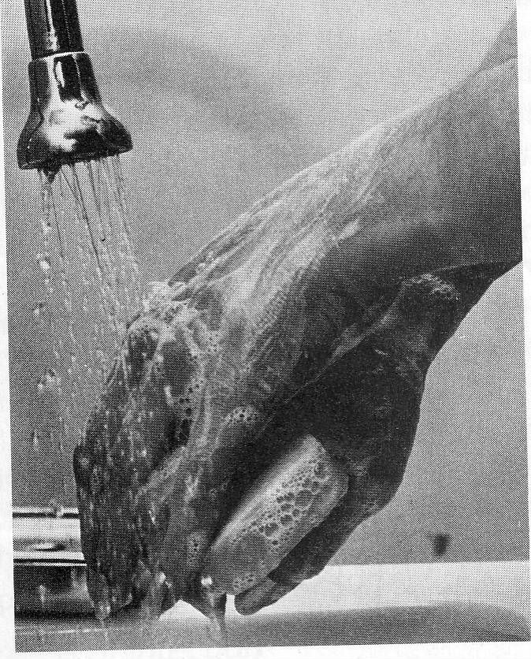
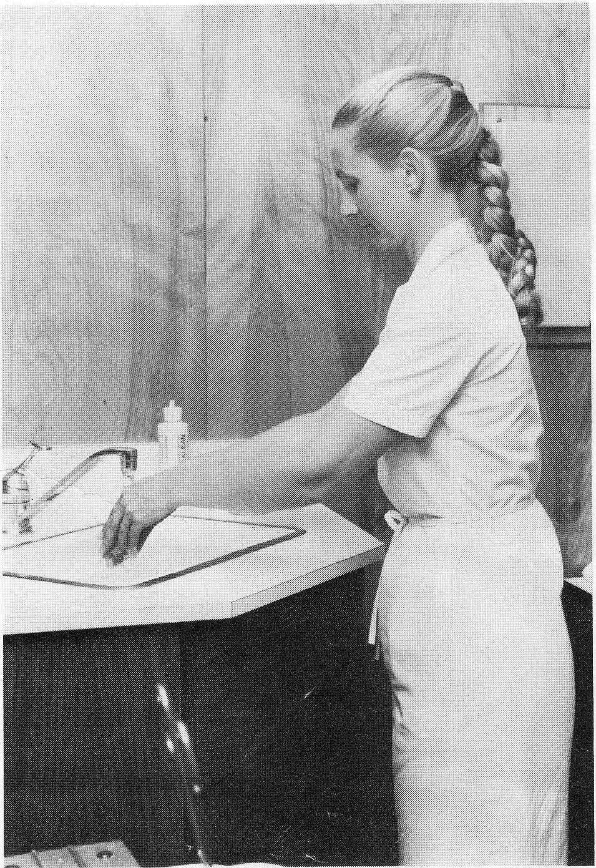
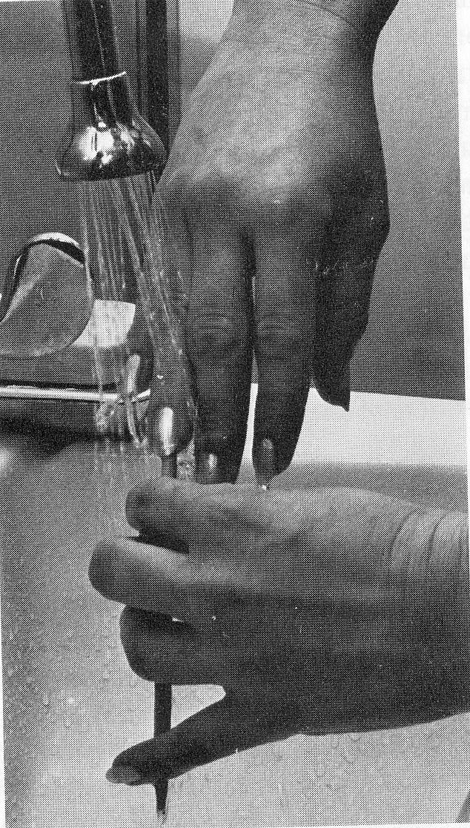
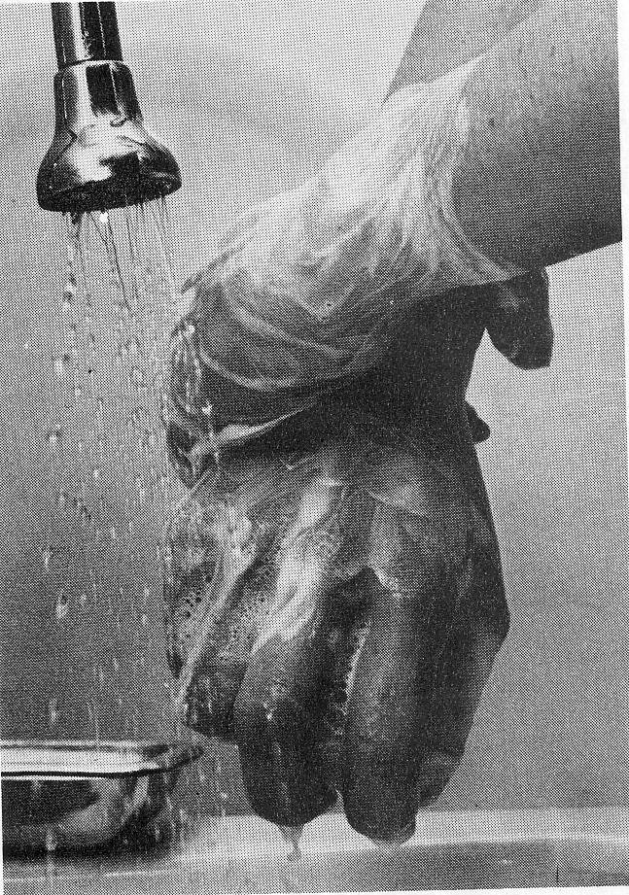
Action in pictures

Slide 58
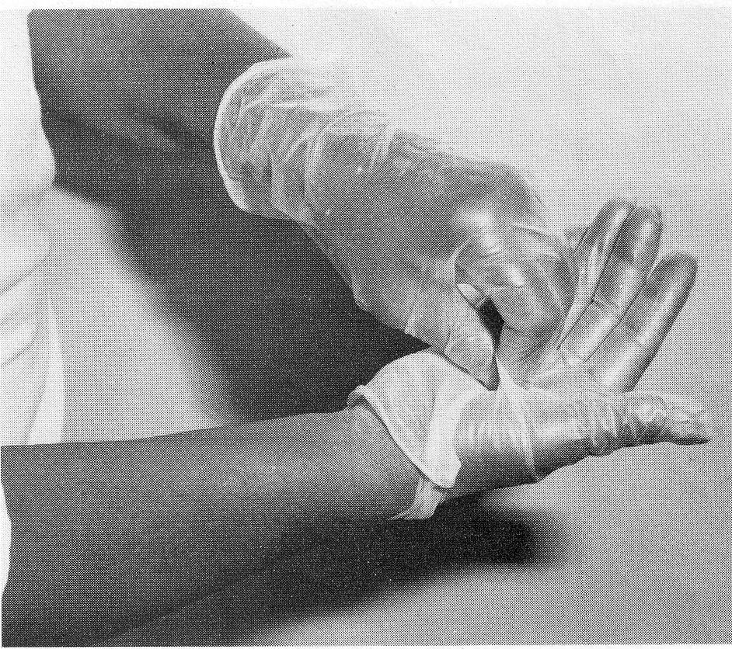
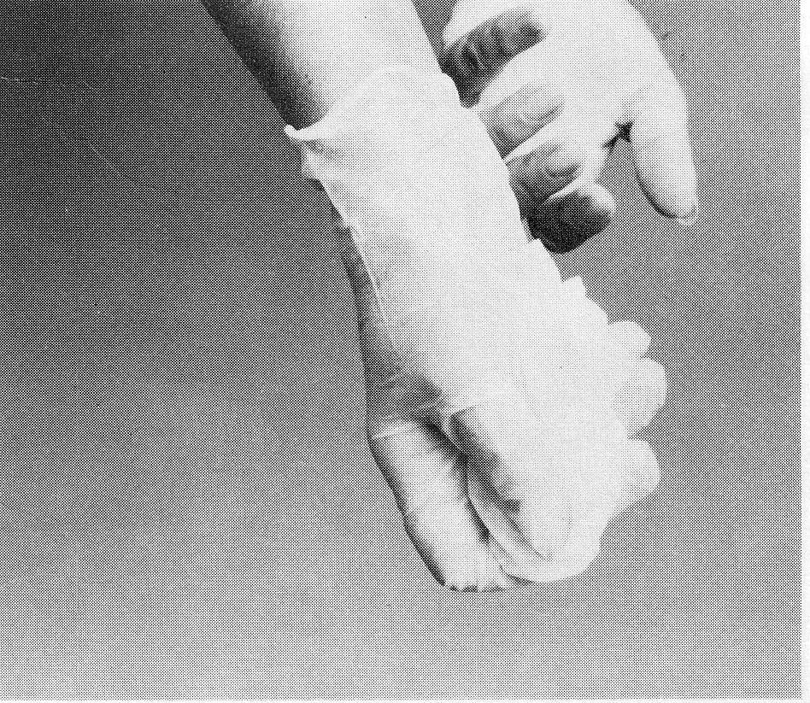
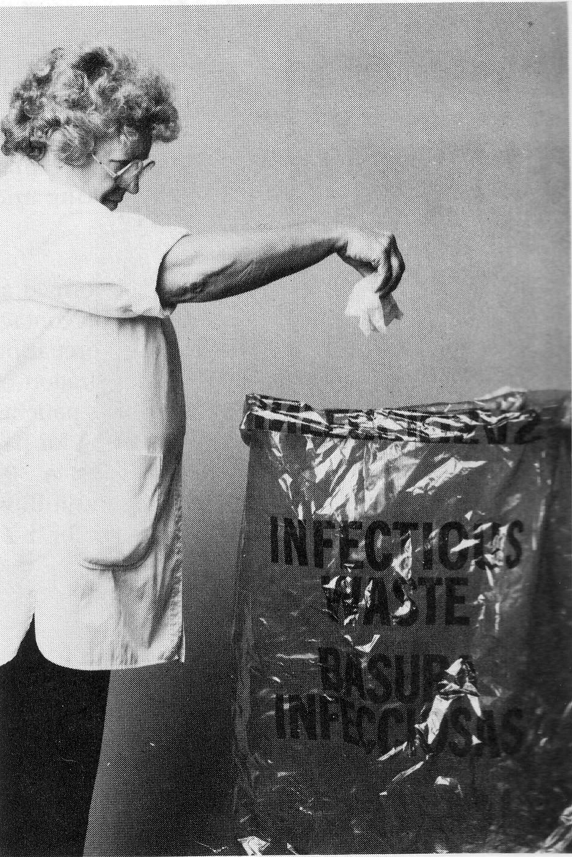
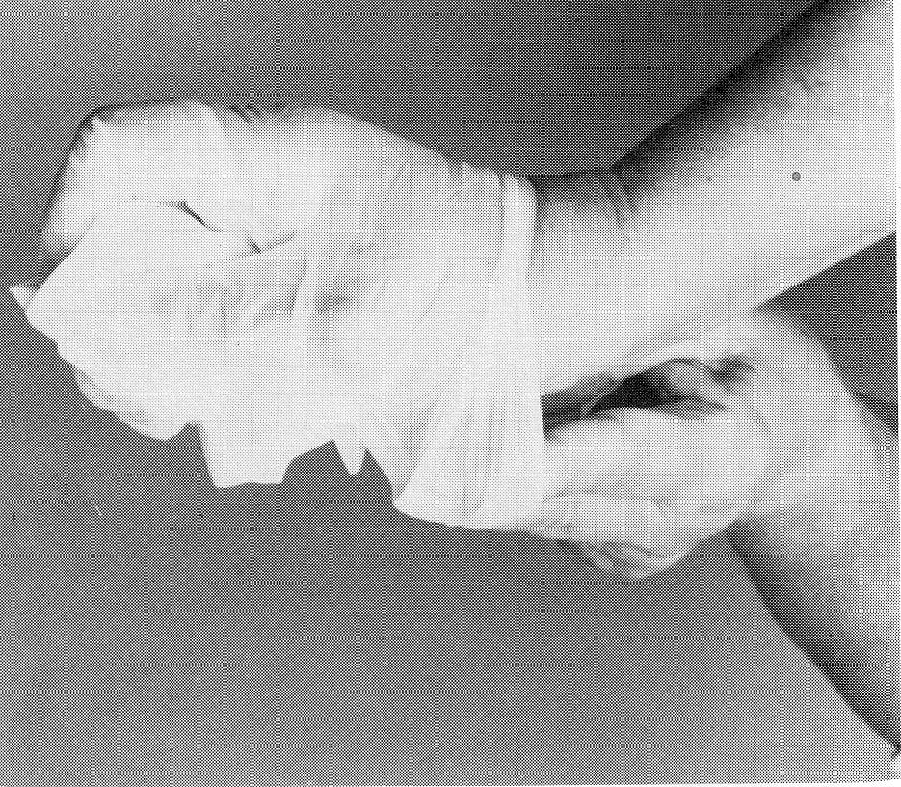
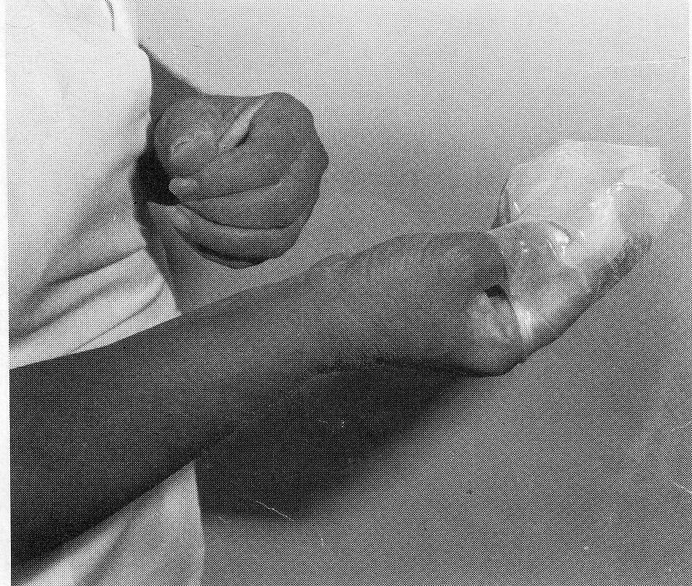
Removing gloves

Slide 59
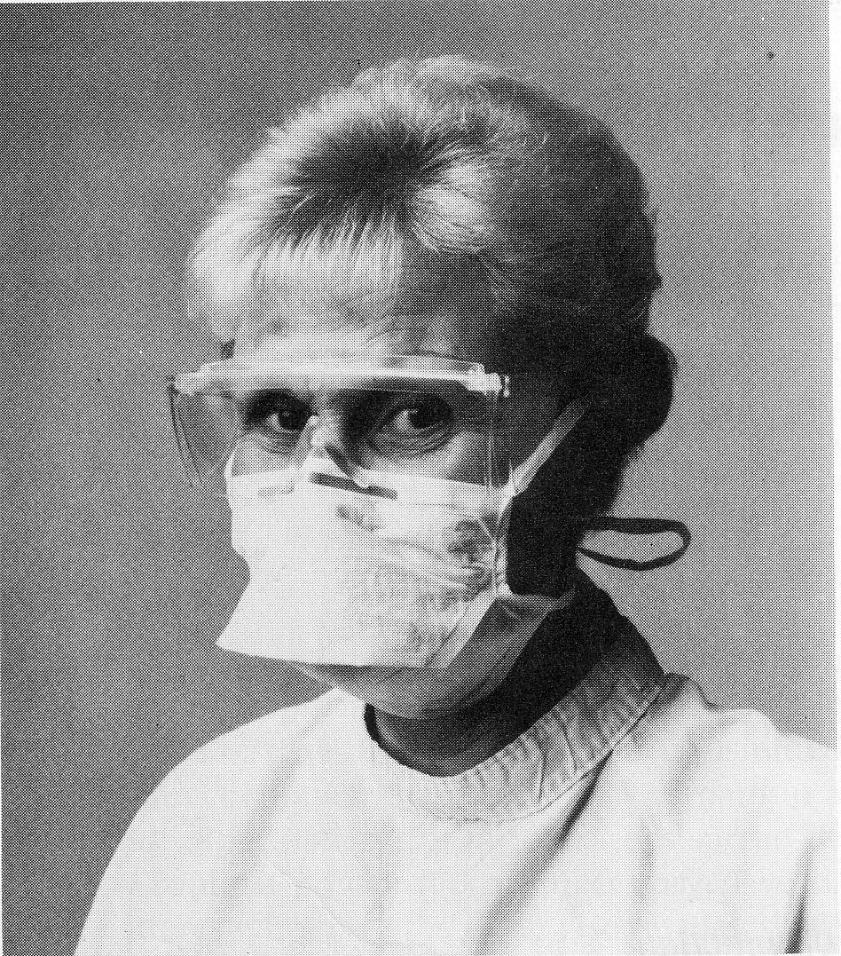
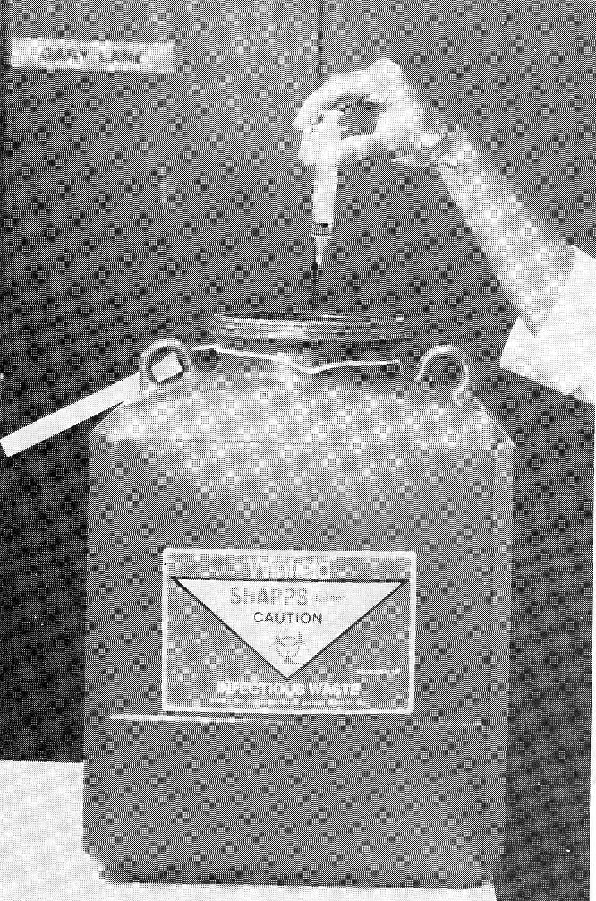
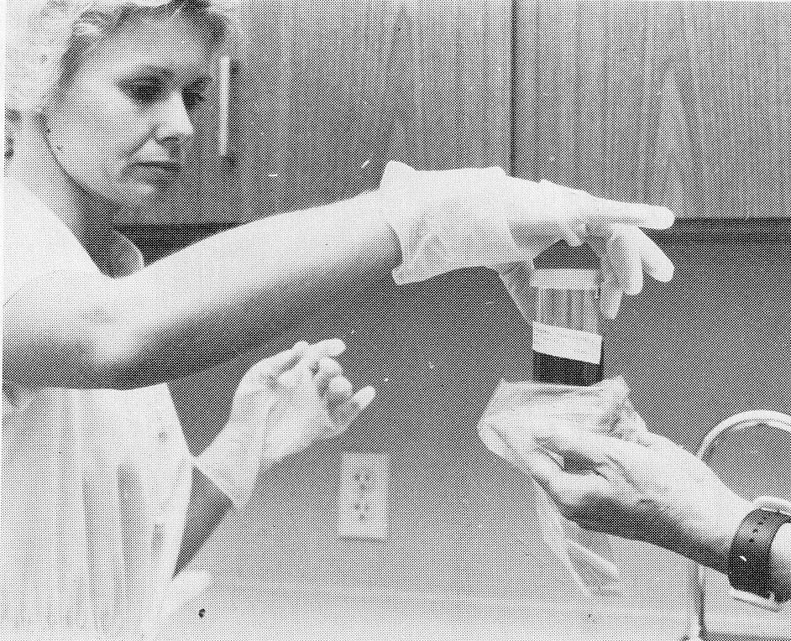

Slide 60
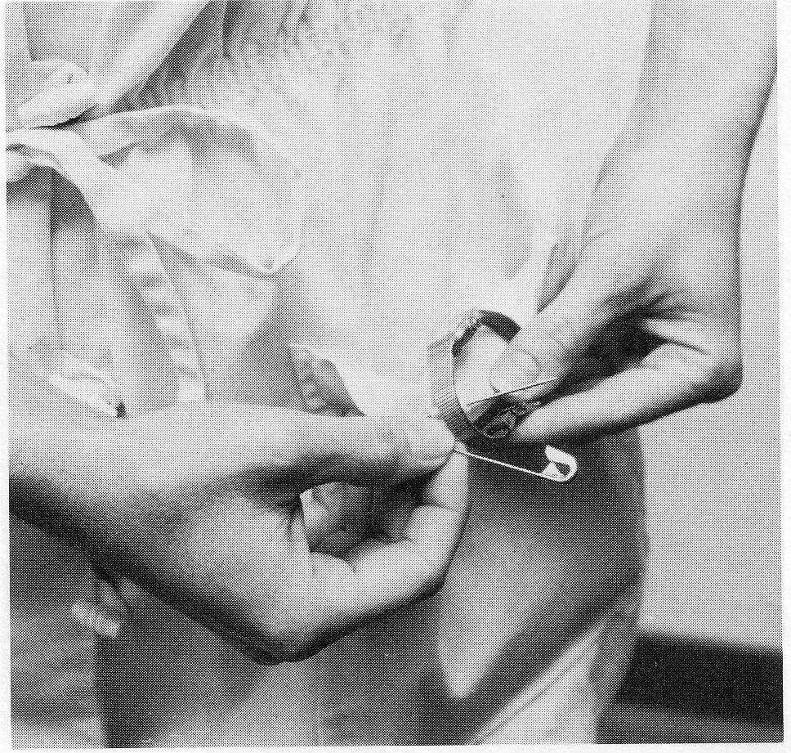
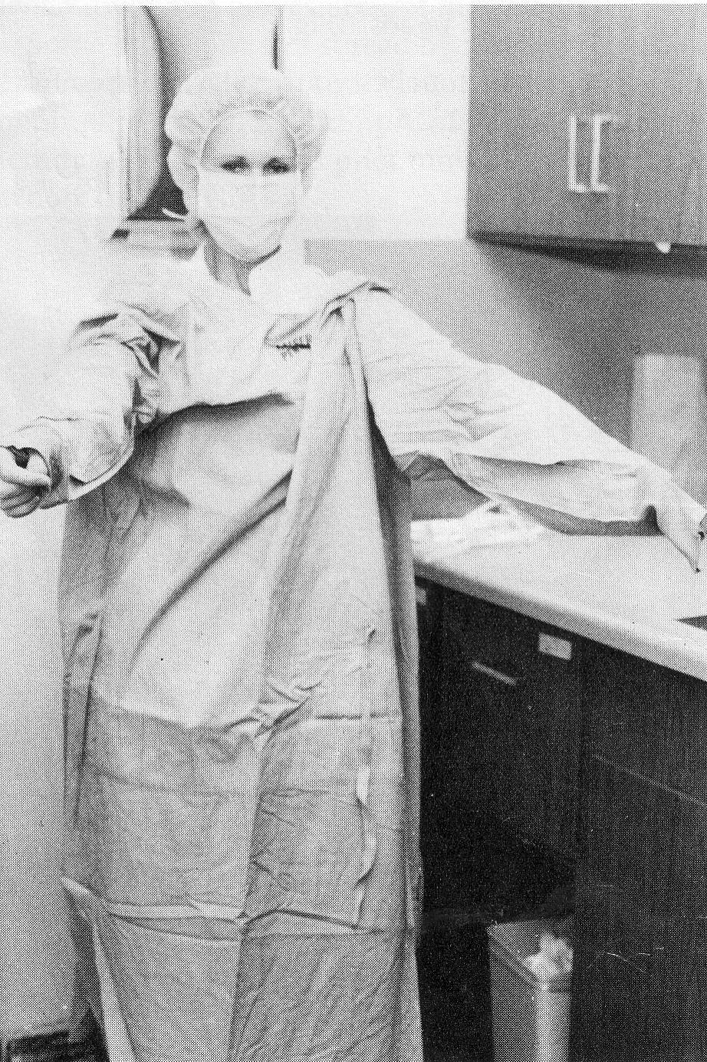
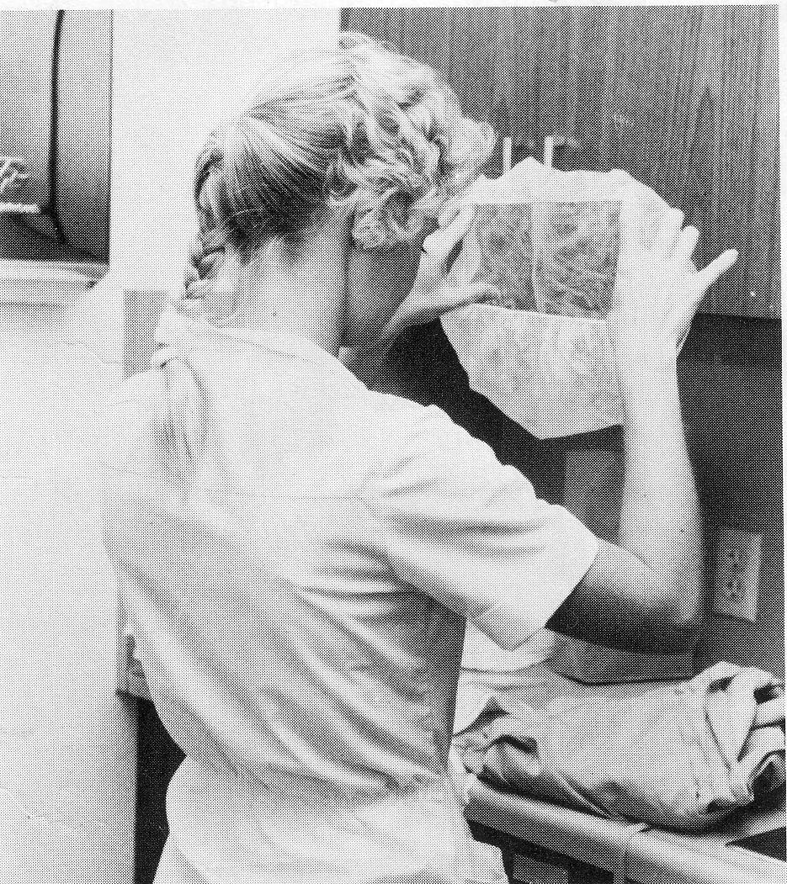
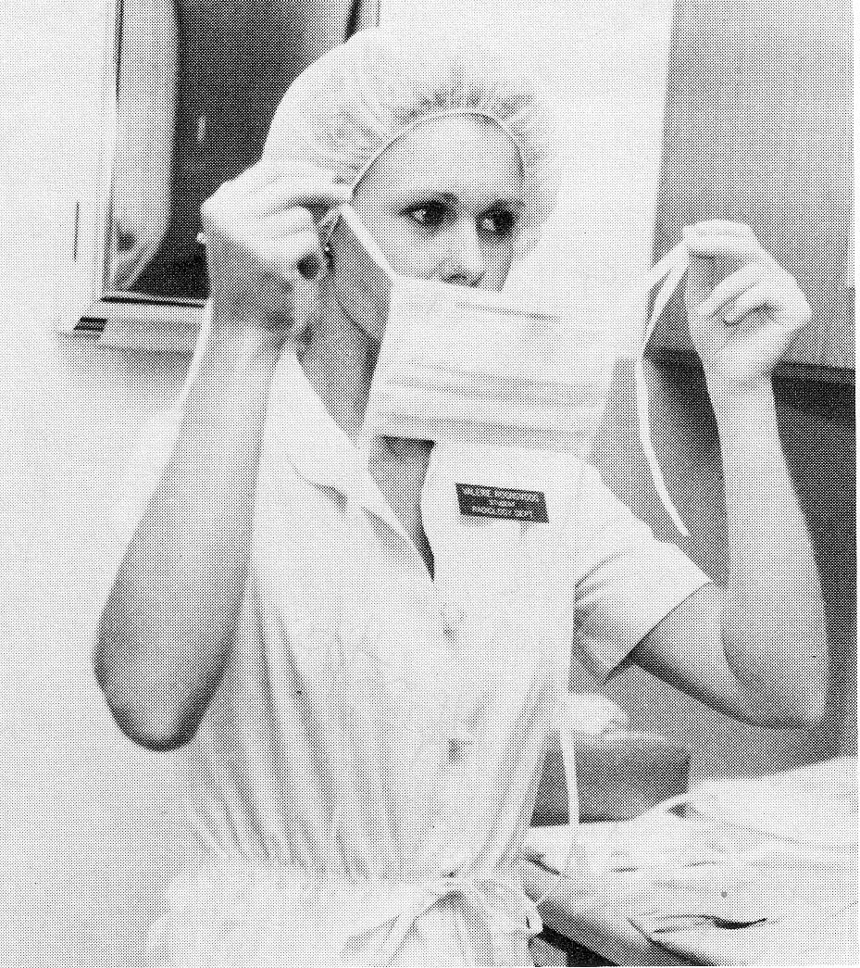
In the strict isolation room

Slide 61
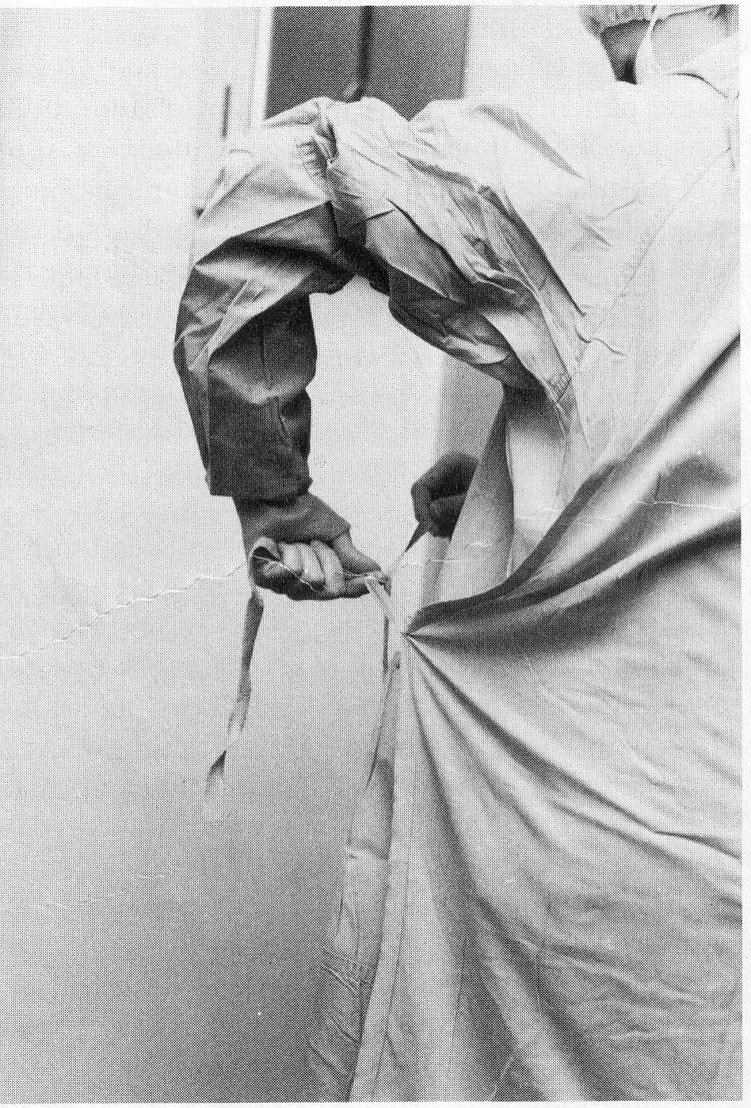
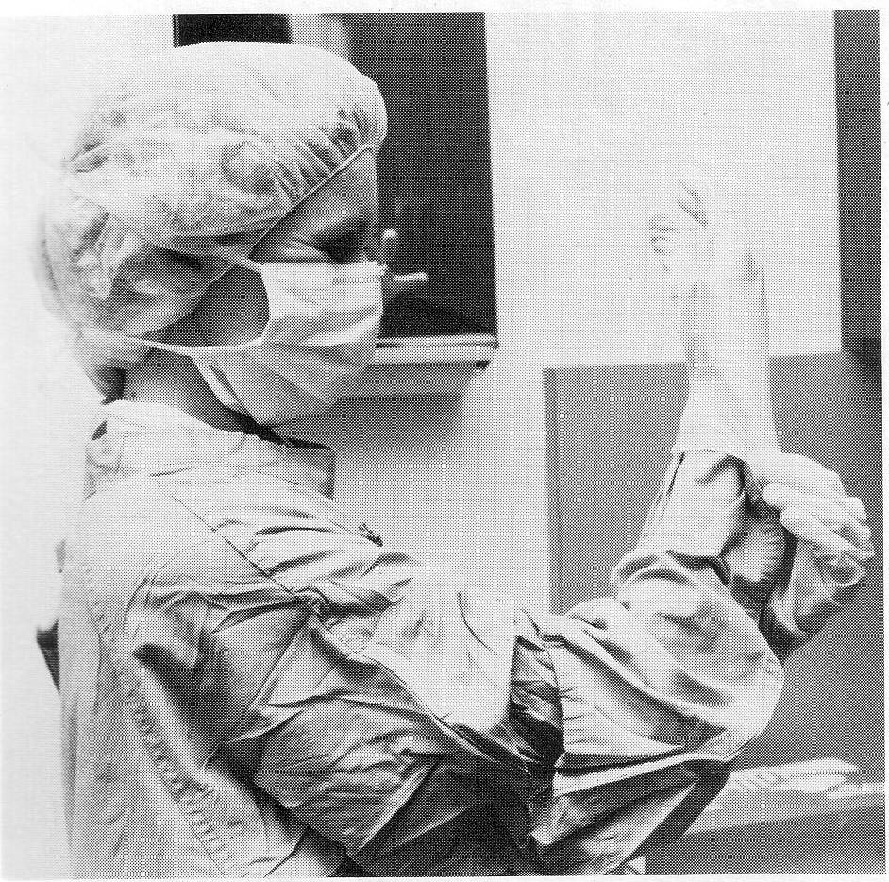
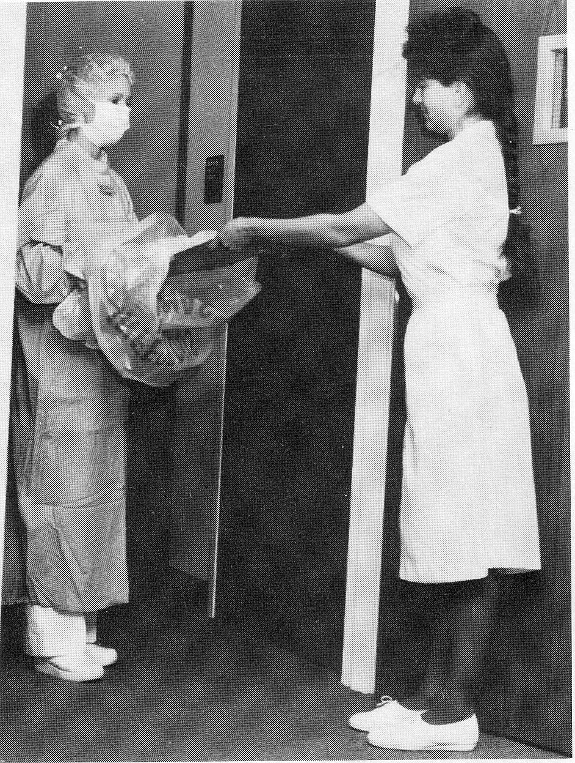
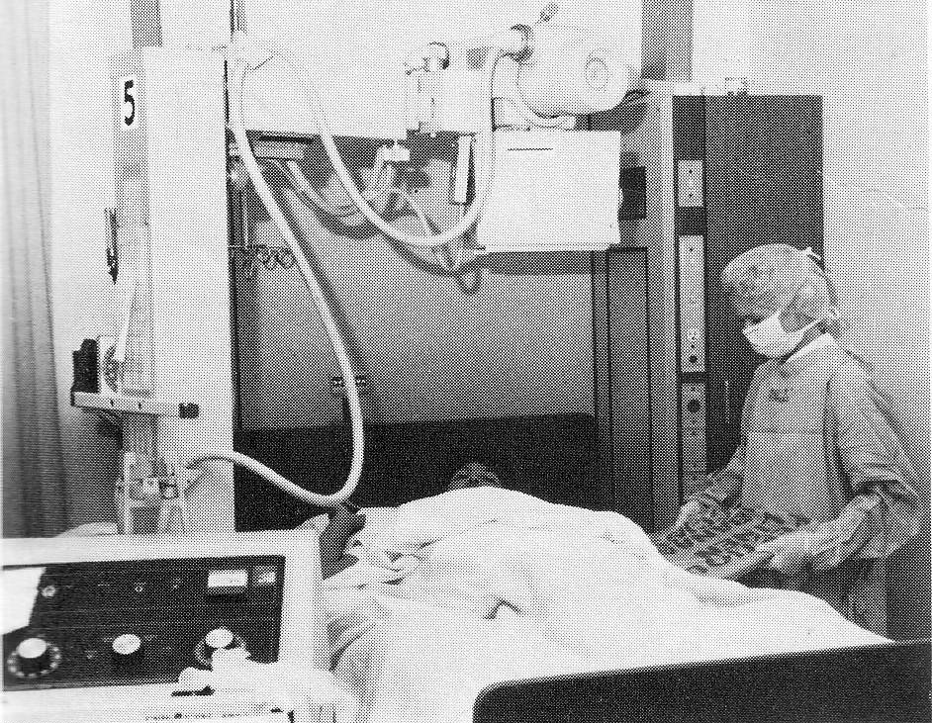

Slide 62
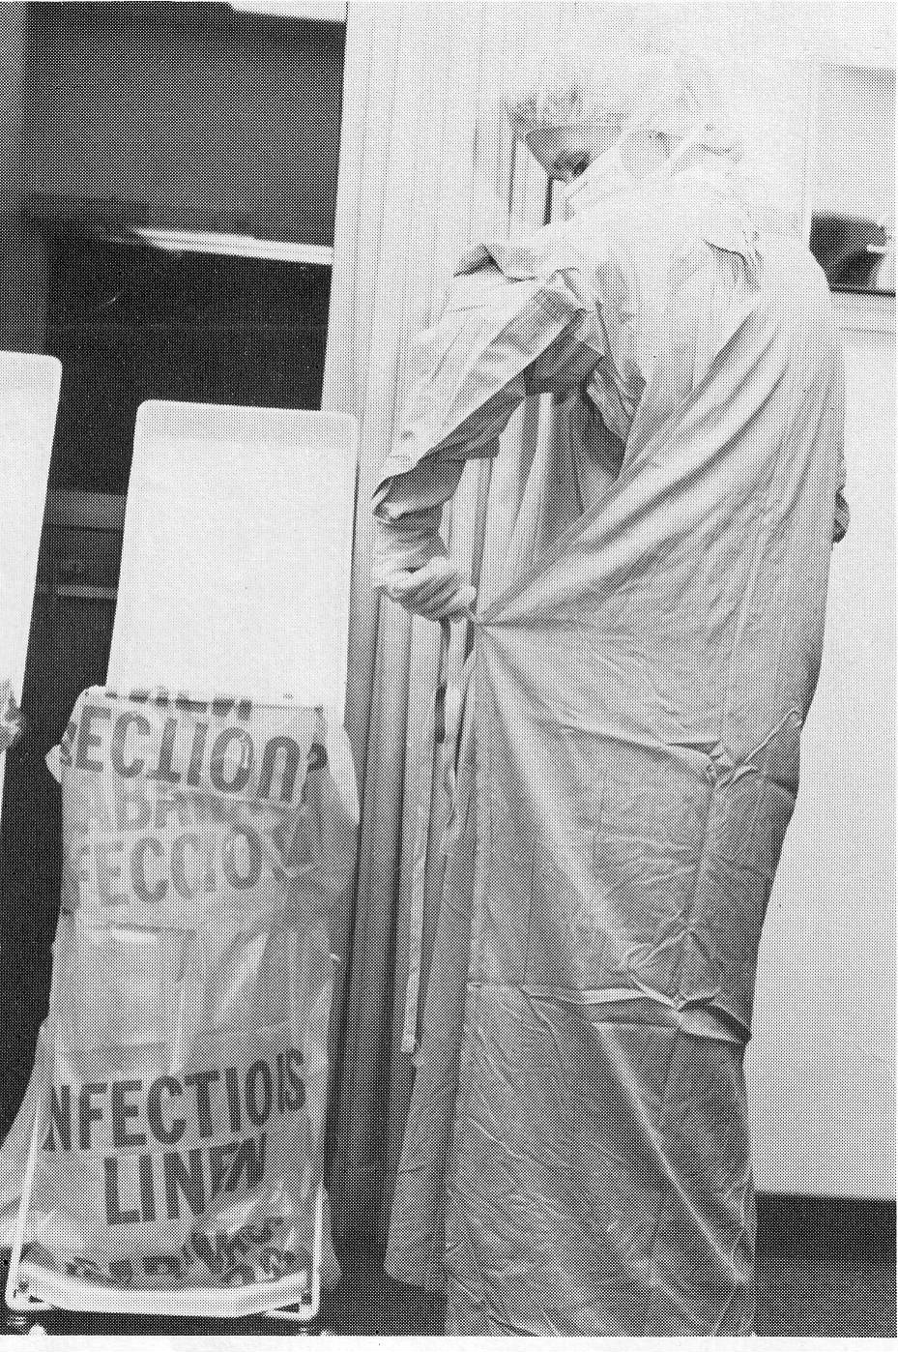
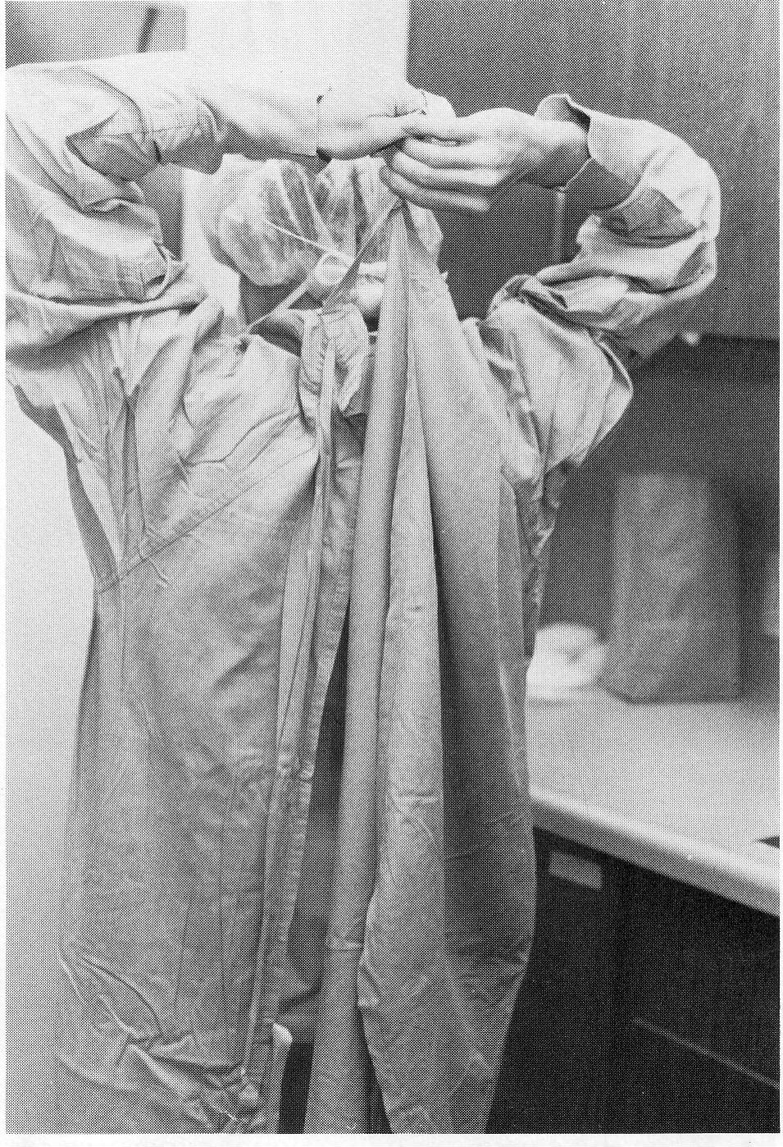
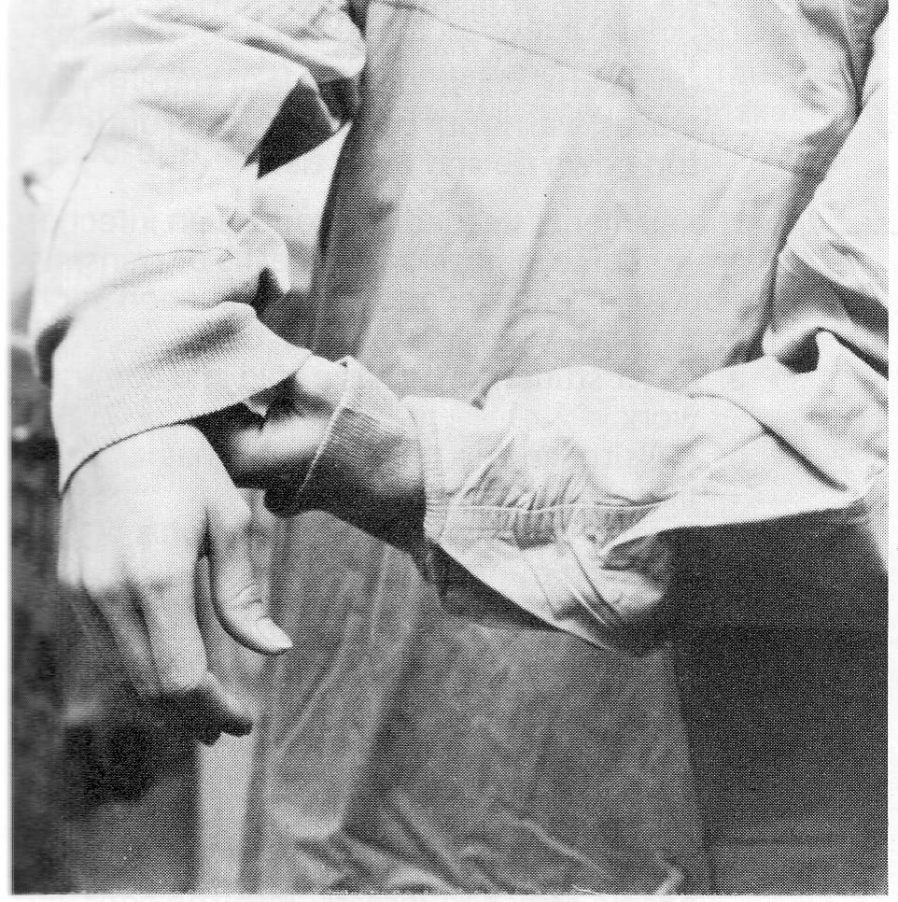
Removing protective gown

Slide 63
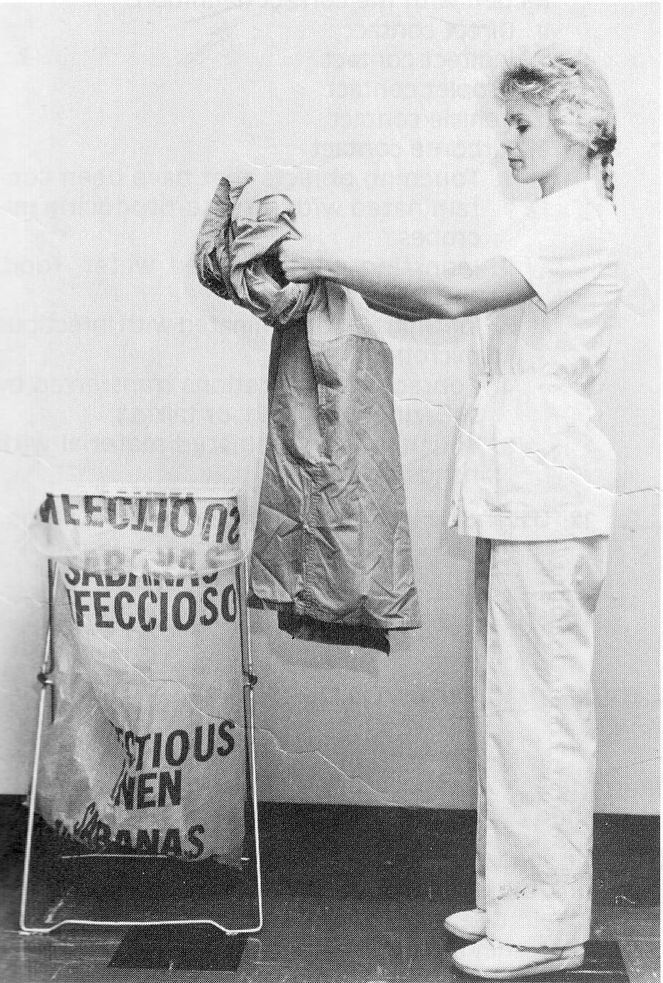
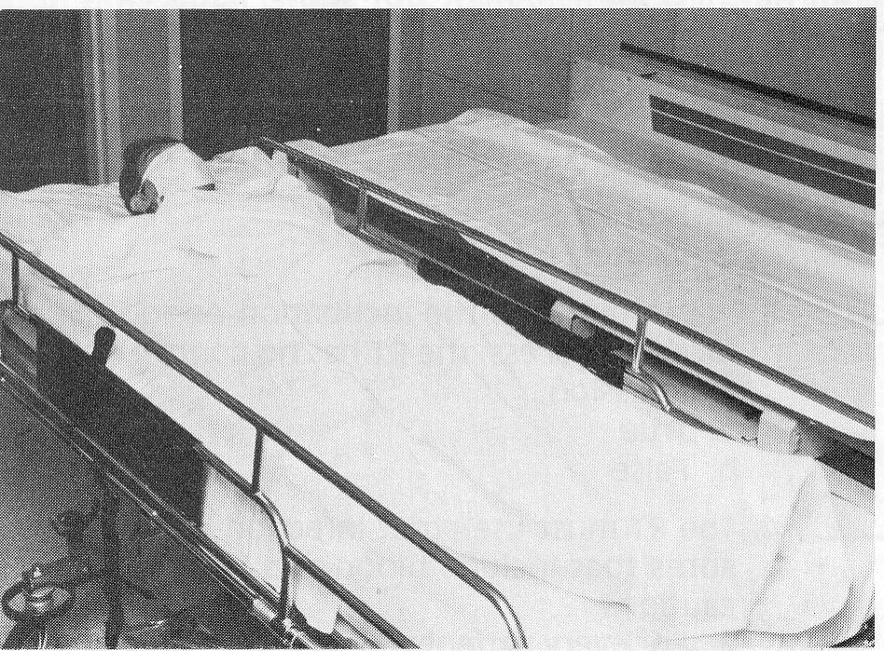
Transferring Pt with communicable disease

Slide 64
Summary

